Slide 1
Lecture 11
Harmony of the Self with the Body

Slide 2


Slide 3
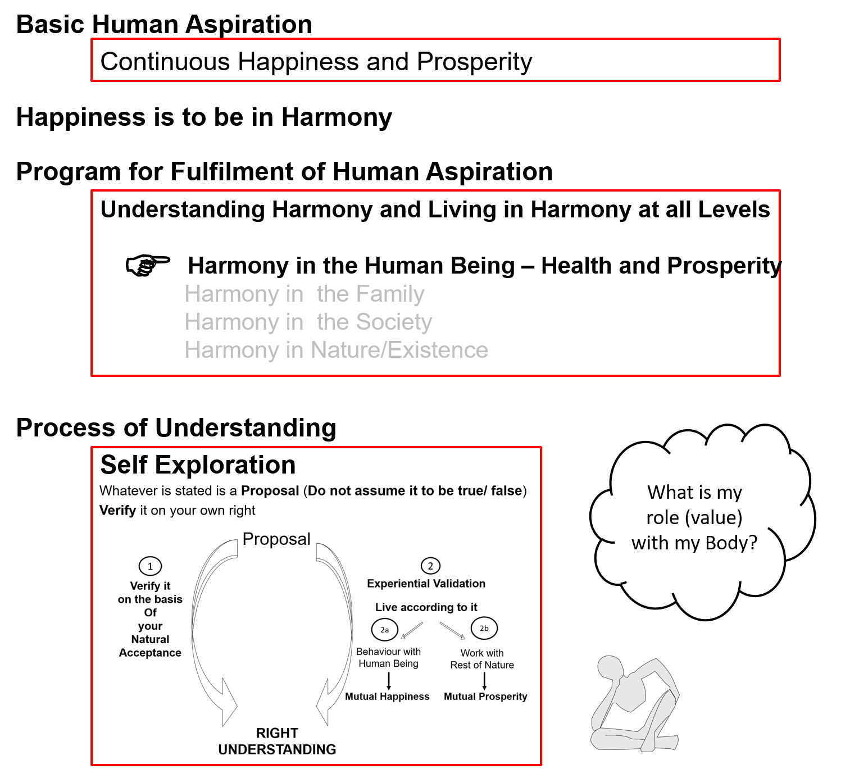

Slide 4
Human Being Ekkuo | Self eSa | Body “kjhj
Need vko';drk | Happiness (e.g. Respect) lq[k ¼tSls lEeku½ | Physical Facility (e.g. Food) lqfo/kk ¼tSls Hkkstu½
In Time dky esa | Continuous fujUrj | Temporary lkef;d
In Quantity ek=k esa | Qualitative (is Feeling) xq.kkRed ¼Hkko gS½ | Quantitative (Required in Limited Quantity) Ekk=kRed ¼lhfer ek=k esa½
Fulfilled By iwfrZ ds fy, | Right Understanding & Right Feeling lgh le>] lgh Hkko | Physio-chemical Things HkkSfrd&jklk;fud oLrq
Activity fØ;k | Desire, Thought, Expectation… bPNk] fopkj] vk”kk--- | Eating, Walking… [kkuk] pyuk---
In Time dky esa | Continuous fujUrj | Temporary lkef;d
Response | Knowing, Assuming, Recognising, Fulfilling tkuuk] ekuuk] igpkuuk] fuokZg djuk | Recognising, Fulfilling igpkuuk] fuokZg djuk
 | Consciousness pSrU; | Material tM+
Co-existence
lgvfLrRo

Slide 5
Self Body
Consciousness |  | Material
I am |  | My body is
I want to live |  | My body is used as an instrument
I want to live with continuous happiness |  | Physical facility is required for nurturing, protection and right utilization of the body
To understand and to live in harmony at all levels of being (from self to entire existence) is my program of action for continuous happiness |  | Production, protection and right utilization of physical facility is a part of my program (<1/4th)
I am the: Seer, Doer, Enjoyer (Experiencer) nz’Vk] drkZ] HkksDrk |  | I use the body as an instrument for fulfillment of my program
INFORMATION
Instruction
Sensation
The Self is
central to human existence
The Body is
an instrument of the Self

Slide 6
Need of the Self Related to Need of the Body
RIGHT UNDERSTANDING
(le>)
in the self
1
Both needs must be satisfied for human-being to be fulfilled
2
RELATIONSHIP (laca/k)
with human beings
3
PHYSICAL FACILITY
(lqfo/kk)
with rest of nature
Feelings
- Trust
- Respect
- …
MUTUAL HAPPINESS
(mHk; lq[k)
MUTUAL PROSPERITY
(mHk; le`f))

Slide 7
Activities of Self eSa dh fdz;k,a
 | Power “kfDr
1.
2.
3. | Desire bPNk
4. | Thought fopkj
5. | Expectation vk'kk
Activity fØz;k
Imaging fp=.k
Analysing-Comparing fo'ys"k.k&rqyu
Selecting-Tasting p;u&vkLoknu
Self verification on the basis of Natural Acceptance
lgt Loh—fr ds vk/kkj ij tkap dj
Self eSa
3
Preconditioning
ekU;rk
1
Imagination
dYiuk”khyrk
Information
Body 'kjhj
2
Sensation
laosnuk
Behaviour O;ogkj
Work dk;Z

Slide 8
Self Body
Consciousness |  | Material
Needs: Happiness, Prosperity → Continuity |  | Physical Facility
Needs & activities are continuous in time |  | Temporary in time
INFORMATION
Instruction
Sensation
Self is central to human existence
Body is
an instrument of the Self

Slide 9
Self Body (Instrument)
Consciousness |  | Material
Needs: Happiness, Prosperity → Continuity |  | Physical Facility
Needs & activities are continuous in time |  | Temporary in time
Self-regulation (संयम)
Feeling of responsibility toward the body – for Nurturing, Protection and Right Utilization of the Body
INFORMATION
Instruction
Sensation
Self is central to human existence
Body is
an instrument of the Self

Slide 10

Self Body (Instrument)
Consciousness |  | Material
Needs: Happiness, Prosperity → Continuity |  | Physical Facility
Needs & activities are continuous in time |  | Temporary in time
Self-regulation (संयम) |  | Health
Feeling of responsibility toward the body – for Nurturing, Protection and Right Utilization of the Body |  | 1. Body acts according to I 2. Parts of the body are in harmony (in order)
INFORMATION
Instruction
Sensation
Physical Facility is required to fulfill the responsibility of the Self toward the Body
(to keep the Body in good health)
– for nurturing, protection and right utilisation of the body
The required physical facility can be identified
Self is central to human existence
Body is
an instrument of the Self

Slide 11

Self Body (Instrument)
Consciousness |  | Material
Needs: Happiness, Prosperity → Continuity |  | Physical Facility
Needs & activities are continuous in time |  | Temporary in time
Self-regulation (संयम) |  | Health
Feeling of responsibility toward the body – for Nurturing, Protection and Right Utilization of the Body |  | 1. Body acts according to I 2. Parts of the body are in harmony (in order)
Food… Clothes, Shelter... Instruments…
INFORMATION
Instruction
Sensation
The required physical facility can be recognised
along with the required quantity
The quantity of food… required for nurturing the body – is it limited or unlimited?
Clothes, shelter… for protection of the body – is it limited or unlimited?
Instruments, equipments… for right utilisation of the body – is it limited or unlimited?
Self is central to human existence
Body is
an instrument of the Self

Slide 12

Self Body (Instrument)
Consciousness |  | Material
Needs: Happiness, Prosperity → Continuity |  | Physical Facility
Needs & activities are continuous in time |  | Temporary in time
Self-regulation (संयम) |  | Health
Feeling of responsibility toward the body – for Nurturing, Protection and Right Utilization of the Body |  | 1. Body acts according to I 2. Parts of the body are in harmony (in order)
Food… Clothes, Shelter... Instruments… Required Required Required in a in limited in limited limited quantity quantity quantity
INFORMATION
Instruction
Sensation
Physical Facility is required to to keep the body in good health,
so that right utilisation of the body can be ensured
i.e. physical Facility is required only for
nurturing, protection and right utilisation of the body
If we can see that, the physical facility for
nurturing, protection and right utilisation of the body
is required in a limited quantity,
then we can understand the meaning of prosperity

Slide 13
Harmony of the Self with the Body = Self-regulation (feeling of responsibility toward the body) in the Self and Health in the Body
Other than these 3 (Nurturing, Protecting and Right Utilization of the Body), what would you need PF for?
The outcome of putting in so much time & effort is only PF – and it has only this much utility
Have you been able to make an assessment of your need for PF?
Are you able to see whether you have more than what your needs are?
Ex: Find out – how much PF is required; how much PF is available; are you prosperous or deprived?

Slide 14
Prosperity (le`f))
Prosperity – The feeling of having / producing more than required Physical Facility
2 1
le`f) & vko”;d lqfo/kk ls vf/kd dh miyfC/k@ mRiknu dk Hkko
1 2
1 – Identification of required physical facility (including the required quantity)
– with right understanding
vko”;d lqfo/kk dk fu/kkZj.k & lgh le> ls
  2 – Ensuring availability/ production of more than required physical facility
  – with right skills
vf/kd dh miyfC/k@ mRiknu] HkkSfrd jklk;fud oLrqvksa dk & lgh gquj ls
A prosperous person thinks of right utilisation, nurturing the other
“ deprived “ “ “ accumulation, exploiting “ “
le`) O;fDr lnqi;ksx dk] nwljs dk iks"k.k djus dk lksprk gS
nfjnz “ laxzg “ “ “ “kks"k.k “ “ “ “

Slide 15

In a previous session, we had seen that we can observe two categories of human beings
blhfy, vHkh nks rjg ds euq”; fn[kkbZ nsrs gSa&
Lacking physical facility, unhappy deprived (lqfo/kk foghu nq[kh nfjnz )
Having physical facility, unhappy deprived (lqfo/kk laiUu nq[kh nfjnz )
While we want to be – tcfd ge gksuk pkgrs gSa&
Having physical facility, happy prosperous (lqfo/kk laiUu lq[kh le`))
Now we can see that if the identification of required physical facility is missing, then one can only shift between category 1 & category 2
This is possible only with
a- the right identification of required physical facility and
b- availability / production of more than required physical facility

Slide 16
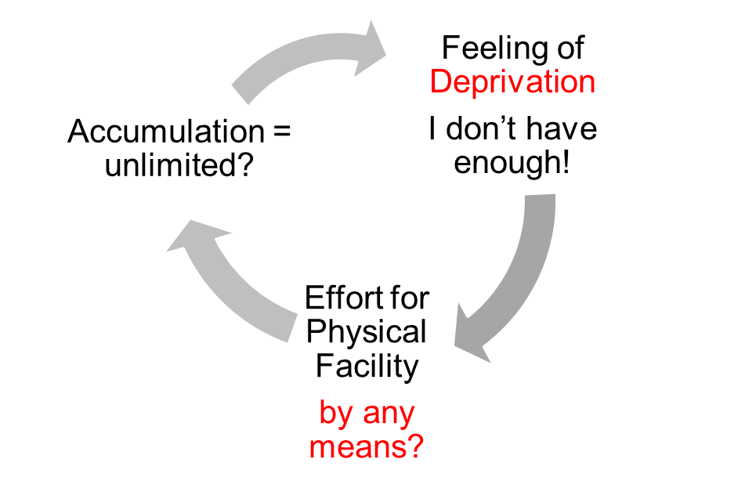
Gross Misunderstanding 1 – Human Being = Body
Human Being Ekkuo | Self (I) eSa | = | Body “kjhj
Need vko’;drk | Respect lEeku | = | Physical Facility (Eg. Food, Clothes) lqfo/kk (tSls&Hkkstu] diM+k)
 | Continuous fujUrj | = | Unlimited vlhfer
Accumulation of Physical Facility – Unlimited!
Lqfo/kk laxzg & vlhfer!
Loop
Check if you
are caught up
In this loop
Deprivation
nfjnzrk

Slide 17
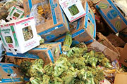
Gross Misunderstanding 2 – Resources are less than our need
Data: Of the 4.2 billion tons of food produced, more than 1 billion tons of food is lost or wasted every year, UN-backed report finds (11 May 2011)
About a third of all the food produced for human consumption each year – or roughly 1.3 billion tons – is lost or wasted, according to a new study commissioned by the United Nations Food and Agriculture Organization (FAO)
Global Food Production is 6 times requirement
Global Food Wastage is 1/3rd of production
Wastage is enough to feed 1300 crore people/year
Have we understood human needs?
Have we understood right utilisation?
Is it a question of production or distribution?
Is it a question of relationship?
Is it a question of right understanding?
It is a question of right education-sanskar
http://www.un.org/apps/news/story.asp?NewsID=38344&Cr=fao&Cr1

Slide 18
Right Utilisation of Physical Facility
Indulgence – Happiness from sensation
Renunciation
Right Utilisation – Relationship, Order

Slide 19
Right Utilisation of Physical Facility
Purposefulness –
Transformation to
Human
Conciousness
Right Utilisation – Relationship,
Order
Utilisation – Family
Use – Body
Indulgence – Taste
Over Indulgence
Obsession for Indulgence
– Sensual
Pleasure
Á;kstuh;rk & thou tkx`fr
lnqi;ksx & laca/k] O;oLFkk
mi;ksx & ifjokj
miHkksx & 'kjhj
Hkksx & bafæ; lq[k
cgqHkksx
vfrHkksx ¼Hkksx mUekn½
KkuiwoZd
With Right Understanding
vKkurko'k
Without Right Understanding

Slide 20
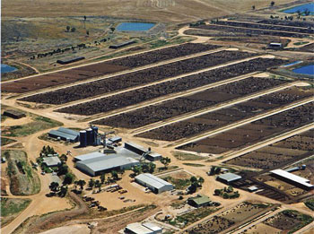
Even Small Individual Choices Add Up E.g. Choice of Food
20% of all life produced on land every year is harvested for human purposes
14-16 kg grain & 21,000 litres of water → 1 kg meat
The world's cattle alone (not including other livestock) annually consume food grains enough for 8.7 billion people
Land use – 3¼ acres/person on meat diet vs 0.2 acres/person on veg diet
20% Amazon rain forest (the size of California) destroyed since 1970
80% of this land is used for cattle raising
By feeding grain to livestock, we lose 90% of the protein, 96% of the calories, 99% of its carbohydrates, and 100% of the fiber. Animal-based diets are high in saturated fat, excessive protein and cholesterol, leading to heart disease and stroke (nearly 50% of all deaths in the US)
Video (1 min)
http://www.planetaryrenewal.org/ipr/vegetarian.html

Slide 21
Sum Up
Human being = co-existence of Self (consciousness) and Body (material)
Self is central to human existence, the Body is used as an instrument
The nurturing, protection and right utilisation of the Body is the responsibility of the Self
Physical facility is required to fulfil that responsibility towards the Body
Physical Facility is required, in a limited quantity, for Nurturing, Protection & Right Utilisation of the Body
Prosperity = Feeling of having / producing more than required physical facility
  Identification of required physical facility (including the required quantity) – with right understanding
  Ensuring availability/ production of more than required physical facility – with right skills

Slide 22
Self Reflection

Slide 23
Self Reflection
Do you have a feeling of Self-regulation (responsibility toward your body)? – continuous?
Is your body healthy?
Find out – how much physical facility is required in your family; how much physical facility is available. An on that basis are you prosperous or deprived?
Do you have a feeling of prosperity? – continuous?
Do you think of
    Right utilisation of physical facility and nurturing others (human beings / rest of nature)?
    Accumulating more physical facility or exploiting others?

Slide 24
Key Points
Harmony of the Self with the Body

Slide 26
Human Being Ekkuo | Self eSa | Body “kjhj
Need vko';drk | Happiness (e.g. Respect) lq[k ¼tSls lEeku½ | Physical Facility (e.g. Food) lqfo/kk ¼tSls Hkkstu½
In Time dky esa | Continuous fujUrj | Temporary lkef;d
In Quantity ek=k esa | Qualitative (is Feeling) xq.kkRed ¼Hkko gS½ | Quantitative (Required in Limited Quantity) Ekk=kRed ¼lhfer ek=k esa½
Fulfilled By iwfrZ ds fy, | Right Understanding & Right Feeling lgh le>] lgh Hkko | Physio-chemical Things HkkSfrd&jklk;fud oLrq
Activity fØ;k | Desire, Thought, Expectation… bPNk] fopkj] vk”kk--- | Eating, Walking… [kkuk] pyuk---
In Time dky esa | Continuous fujUrj | Temporary lkef;d
Response | Knowing, Assuming, Recognising, Fulfilling tkuuk] ekuuk] igpkuuk] fuokZg djuk | Recognising, Fulfilling igpkuuk] fuokZg djuk
 | Consciousness pSrU; | Material tM+
Co-existence
lgvfLrRo

Slide 27
Self Body (Instrument)
Consciousness Self |  | Material Body
Needs: Happiness, Prosperity → Continuity |  | Physical Facility
Needs & activities are continuous in time |  | Temporary in time
Self-regulation (संयम) |  | Health
Feeling of responsibility toward the body – for Nurturing, Protection and Right Utilization of the Body |  | 1. Body acts according to I 2. Parts of the body are in harmony (in order)
Food… Clothes, Shelter... Instruments… Required Required Required in a in limited in limited limited quantity quantity quantity
INFORMATION
Instruction
Sensation
Physical Facility is required to to keep the body in good health,
so that right utilisation of the body can be ensured
i.e. physical Facility is required only for
nurturing, protection and right utilisation of the body
If we can see that, the physical facility for
nurturing, protection and right utilisation of the body
is required in a limited quantity,
then we can understand the meaning of prosperity

Slide 28
Prosperity (le`f))
Prosperity – The feeling of having / producing more than required Physical Facility
2 1
le`f) & vko”;d lqfo/kk ls vf/kd dh miyfC/k@ mRiknu dk Hkko
1 2
1 – Identification of required physical facility (including the required quantity)
– with right understanding
vko”;d lqfo/kk dk fu/kkZj.k & lgh le> ls
  2 – Ensuring availability/ production of more than required physical facility
  – with right skills
vf/kd dh miyfC/k@ mRiknu] HkkSfrd jklk;fud oLrqvksa dk & lgh gquj ls
A prosperous person thinks of right utilisation, nurturing the other
“ deprived “ “ “ accumulation, exploiting “ “
le`) O;fDr lnqi;ksx dk] nwljs dk iks"k.k djus dk lksprk gS
nfjnz “ laxzg “ “ “ “kks"k.k “ “ “ “

Slide 29
Gross Misunderstanding 1 – Human Being = Body
Human Being Ekkuo | Self (I) eSa | = | Body “kjhj
Need vko’;drk | Respect lEeku | = | Physical Facility (Eg. Food, Clothes) lqfo/kk (tSls&Hkkstu] diM+k)
 | Continuous fujUrj | = | Unlimited vlhfer
Accumulation of Physical Facility – Unlimited!
Lqfo/kk laxzg & vlhfer!
Loop
Check if you
are caught up
In this loop
Deprivation
nfjnzrk

Slide 30
Gross Misunderstanding 2 – Resources are less than our need
Data: Of the 4.2 billion tons of food produced, more than 1 billion tons of food is lost or wasted every year, UN-backed report finds (11 May 2011)
About a third of all the food produced for human consumption each year – or roughly 1.3 billion tons – is lost or wasted, according to a new study commissioned by the United Nations Food and Agriculture Organization (FAO)
Global Food Production is 6 times requirement
Global Food Wastage is 1/3rd of production
Wastage is enough to feed 1300 crore people/year
Have we understood human needs?
Have we understood right utilisation?
Is it a question of production or distribution?
Is it a question of relationship?
Is it a question of right understanding?
It is a question of right education-sanskar
http://www.un.org/apps/news/story.asp?NewsID=38344&Cr=fao&Cr1

Slide 31
Right Utilisation of Physical Facility
Purposefulness –
Transformation
Right Utilisation – Relationship,
Order
Utilisation – Family
Use – Body
Indulgence – Taste
Over Indulgence
Obsession for Indulgence
– Sensual
Pleasure
Á;kstuh;rk & thou tkx`fr
lnqi;ksx & laca/k] O;oLFkk
mi;ksx & ifjokj
miHkksx & 'kjhj
Hkksx & bafæ; lq[k
cgqHkksx
vfrHkksx ¼Hkksx mUekn½
KkuiwoZd
With Right Understanding
vKkurko'k
Without Right Understanding

Slide 32
Even Small Individual Choices Add Up E.g. Choice of Food
20% of all life produced on land every year is harvested for human purposes
14-16 kg grain & 21,000 litres of water → 1 kg meat
The world's cattle alone (not including other livestock) annually consume food grains enough for 8.7 billion people
Land use – 3¼ acres/person on meat diet vs 0.2 acres/person on veg diet
20% Amazon rain forest (the size of California) destroyed since 1970
80% of this land is used for cattle raising
By feeding grain to livestock, we lose 90% of the protein, 96% of the calories, 99% of its carbohydrates, and 100% of the fiber. Animal-based diets are high in saturated fat, excessive protein and cholesterol, leading to heart disease and stroke (nearly 50% of all deaths in the US)
Video (1 min)
http://www.planetaryrenewal.org/ipr/vegetarian.html

Slide 33
Sum Up
Human being = co-existence of Self (consciousness) and Body (material)
Self is central to human existence, the Body is used as an instrument
The nurturing, protection and right utilisation of the Body is the responsibility of the Self
Physical facility is required to fulfil that responsibility towards the Body
Physical Facility is required, in a limited quantity, for Nurturing, Protection & Right Utilisation of the Body
Prosperity = Feeling of having / producing more than required physical facility
  Identification of required physical facility (including the required quantity) – with right understanding
  Ensuring availability/ production of more than required physical facility – with right skills

Slide 34
FAQs for Lecture 11
Harmony of the Self with the Body

Slide 35
Preamble
Now with the clarity of human being as co-existence of Self and Body, the needs can be more precisely identified and prosperity can be discussed with more definiteness
While many questions regarding prosperity have been discussed in earlier lectures (particularly lectures 3, 5 and 6), we can revisit some of these questions and discuss few new questions

Slide 36
Question(s): Response
Why do we need “more than required” physical facility to feel prosperous?
To ensure Prosperity-
We identify the required physical facility for the family (including the required quantity) – with right understanding
We produce more than the required physical facility using cyclic, mutually enriching process – with right skills
We consume as much as is required (for nurturing, protection & right utilisation of the body), and not more – with a feeling of Self-regulation
We share the rest for mutual fulfillment in relationship and for order in society – with a sense of responsibility in relationship
So that more is for sharing in relationship, not for indulgence or over-consumption.

Slide 37
Question(s): Response
Can we really identify our need? How much money is really required- can we determine?
I am asking because prices keep changing and there is no guarantee that we will not have some accident or some illness where we don’t know how much the treatment will cost. We have to include insurance for all these contingencies…
We can certainly identify the need of physical facility for nurturing, protection and right utilisation of the body as discussed in the session.
However, when we try to convert it into money or any currency, there may be problem because the terms of exchange of physical facility with respect to money (or currency) is defined by the human being, by the prevailing norms in the society. In societal setup where there is unequal terms of exchange (therefore injustice) then certain physical facility may be assigned low price and certain other facilities may be assigned very high price. Even knowledge and feeling which is the activity of consciousness can become a mode of getting money.
Continued…

Slide 38
Response (continued)
If value in terms of money assigned to a particular facility is not defined on the basis of labour that has been put up in producing that facility and its utility then any value can be assigned to the physical facility depending upon the prevailing norms of the society.
Example- Cost of a bread may be 1 rupee when you have to prepare it in home but it may cost 10 rupees or even 100 rupees when you are in a restaurent.
When I was studying at IIT Kanpur, Education fee was 250 rupees per semester, now it is around 1 lakh.
As far as your health problem is concerned, you will never be able to decide how much money will be required, so even insurance will not work.
And when you talk about health, are you talking about keeping your body healthy or getting treatment
One fundamental question regarding insurance is that whether the assurance is in accumulation of physical facility or in relationship and societal system.

Slide 39
Response (continued)
Body Physical Facility Money (Currrency) Digital currency…
Terms of Exchange between
- PF … Currency
- currency 1 … currency 2
(now even Knowledge and currency)
Possible to identify qty Difficult to identify amount of money as
In terms of PF indefinite, unequal terms of exchange…
Existential realities Construct of human being
Governed by Governed by
Existential laws Prevailing man-made regulations
Universal, Definite… Vary from place to place, indefinite…
(made by human beings with right understanding, right feeling?)
(or by people with assumptions, feeling of opposition…?)

Slide 40
Question(s): Response
It is said that “desires are unlimited, resources are limited”. So how can there be prosperity?
Desires, if we understand properly, is definite i.e., continuity of happiness and prosperity.
The amount of physical facility required for ensuring prosperity is limited and can be identified.
Availability of resources in nature and capacity to produce in human being is more than what is required.
Therefore, prosperity is possible for everyone.

Slide 41
Question(s): Response
So many great inventions took place during world wars, like operations research, like radar… If we become satisfied, then there will be no motivation for development. What is your comment on it?
We certainly need development, but, for what? For satisfaction, for fulfillment, isn’t it? How can there be a development which is against satisfaction?
The problem today is that we have not been able to define our need with definiteness, therefore, there is no completion point, it is undefined, open ended. Now, irregard if whatever we achieve, we remain dissatisfied.
As a result, development has no completion point, it is undefined, open ended; we are moving forward but, we don’t know where we want to reach- no clarity about the goal and therefore, the development today is directionless.
…continued

Slide 42
Question(s): Response
So many great inventions took place during world wars, like operations research, like radar… If we become satisfied, then there will be no motivation for development. What is your comment on it?
…continued
We need to work out a process of development with a well defined goal and definite direction. This is what we are trying to do.

